Slide 1
Energy A.I. Hackathon 2023
Team Drillpy
April 11th, 2023
Abraham Montes, Çınar Turhan, Mohammad Abdullah, Ethan Litchauer
Petroleum and Geosystems Engineering, Electrical and Computer Engineering

Slide 2
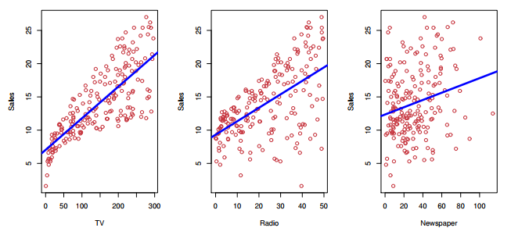
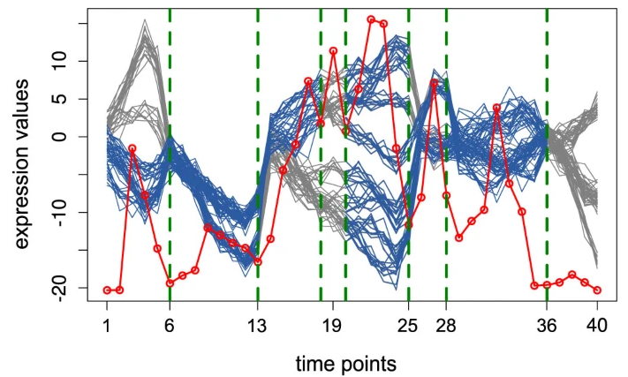
Agenda
Introduction
Why does it matter?
Work breakdown
Data is gold, right?
How we hacked it
How we would hack it again
Wrap up
[James et al 2017]
[Omranian et al 2015]

Slide 3
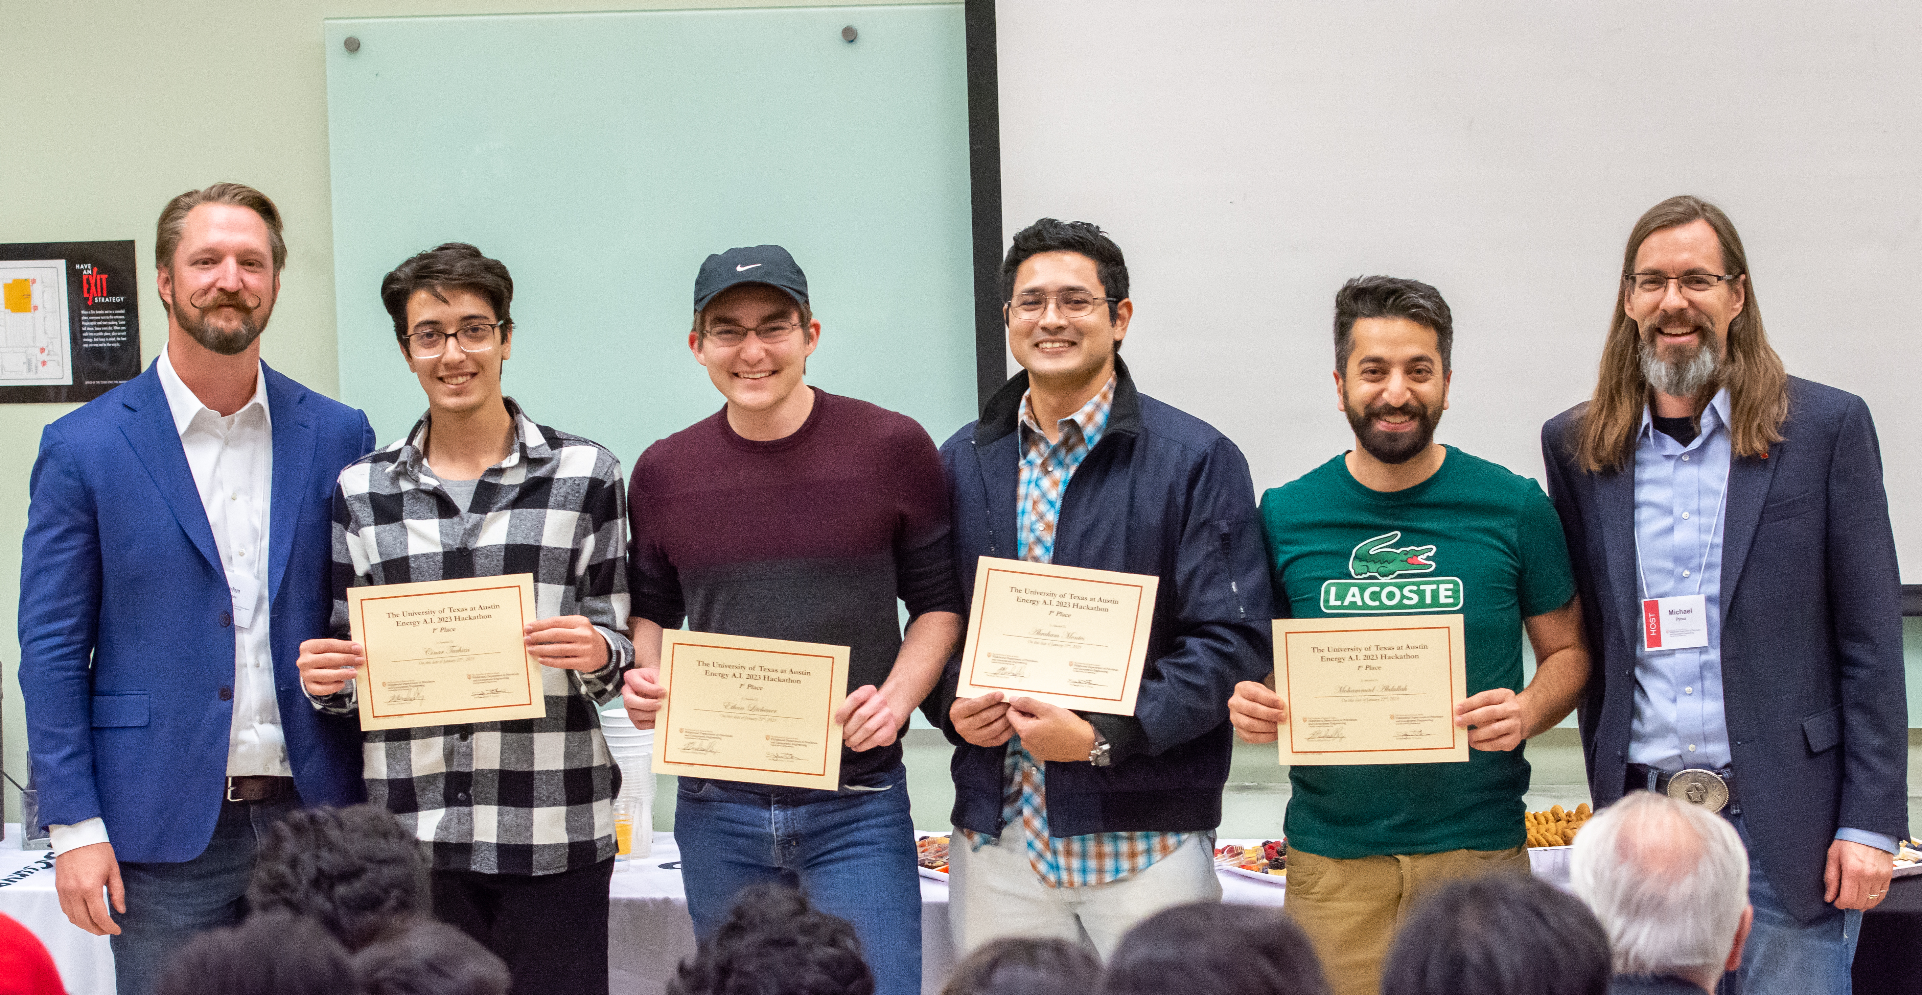
Introduction
Hacker
Studies and Department
Research
Çinar Turhan Master’s student PGE Well repurposing
Ethan Litchauer Undergraduate student ECE Integrated circuits
Abraham Montes PhD student PGE Stuck pipe prediction & analysis
Mohammad Abdullah PhD student PGE Reservoir simulation

Slide 4
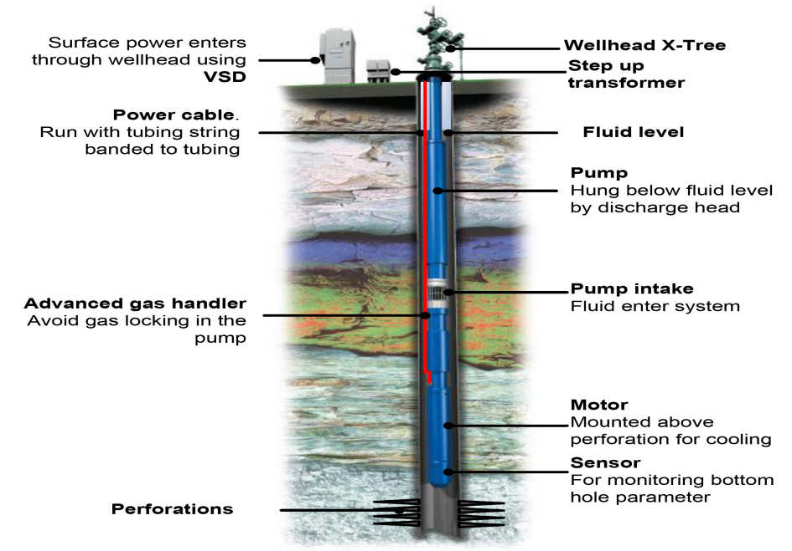
Why does it matter?
Logistics
Preventive maintenance
Aid design enhancement: RCA
Rig job scheduling
[Nuñez et al 2014]

Slide 5
Work breakdown
Literature Review
Exploratory Data Analysis
Model Selection
Feature Engineering
Model

Slide 6
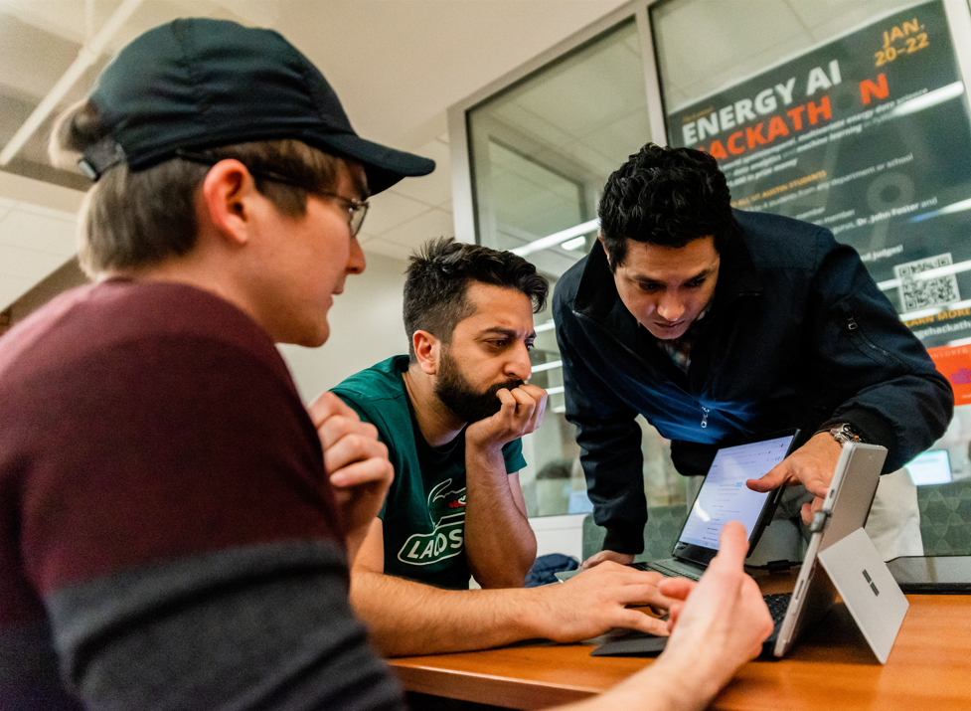
Work breakdown
Literature Review
Finding databases
Search based on title and abstract
Filtering the common features used in previous studies

Slide 7
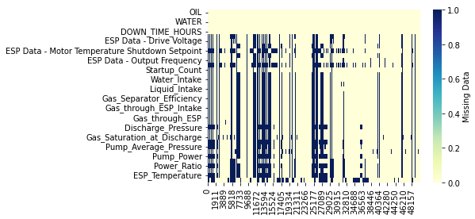
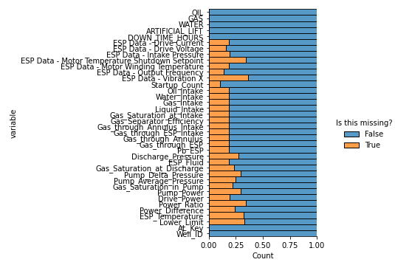
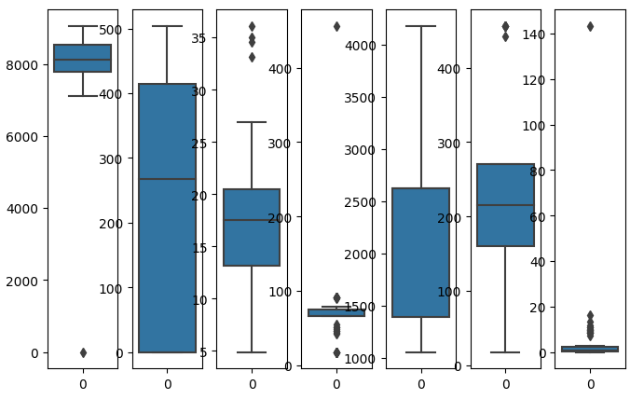
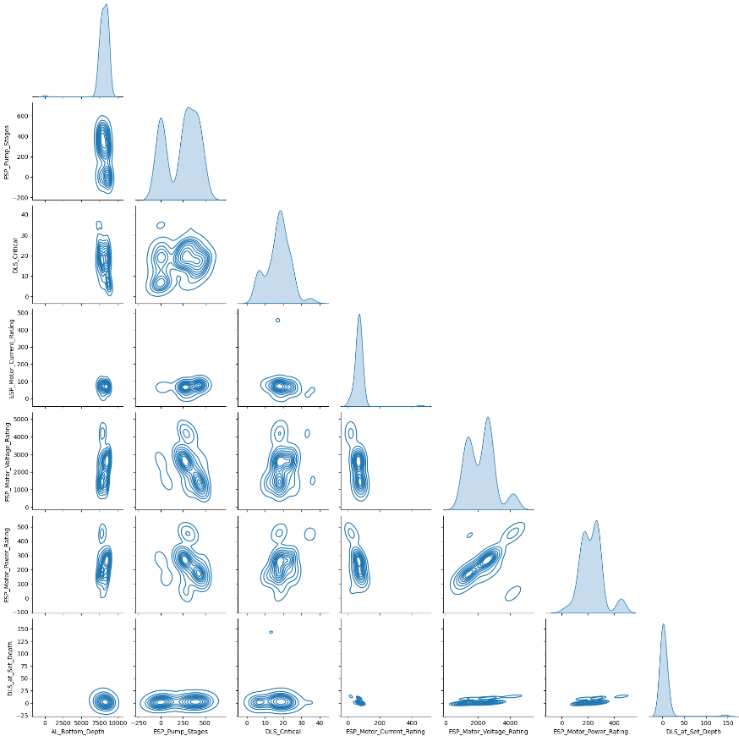
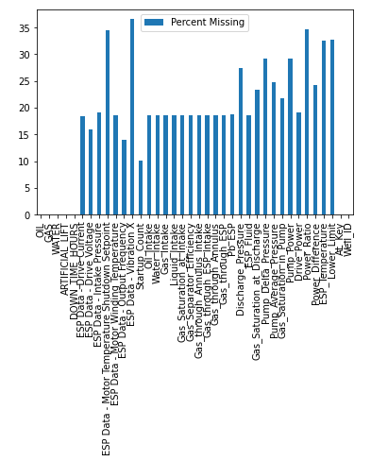
Work breakdown
Data is gold, right?
Exploratory Data Analysis
Data Completeness
Pairplots
Correlations
Outliers
Distributions

Slide 8
Work breakdown
Model Selection
Finding databases
Search based on title and abstract
Filtering the common features used in previous studies

Slide 9
Project Workflow
Literature Review
Exploratory Data Analysis
Model Selection
Feature Engineering
Model

Slide 10
Model
Literature Review
Model
Random Forest
.
.
.
.
.
.
.
Exploratory Data Analysis
Feature Engineering
Model Selection

Slide 11
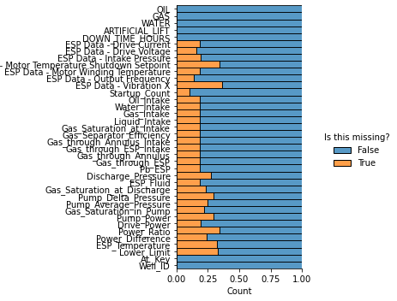
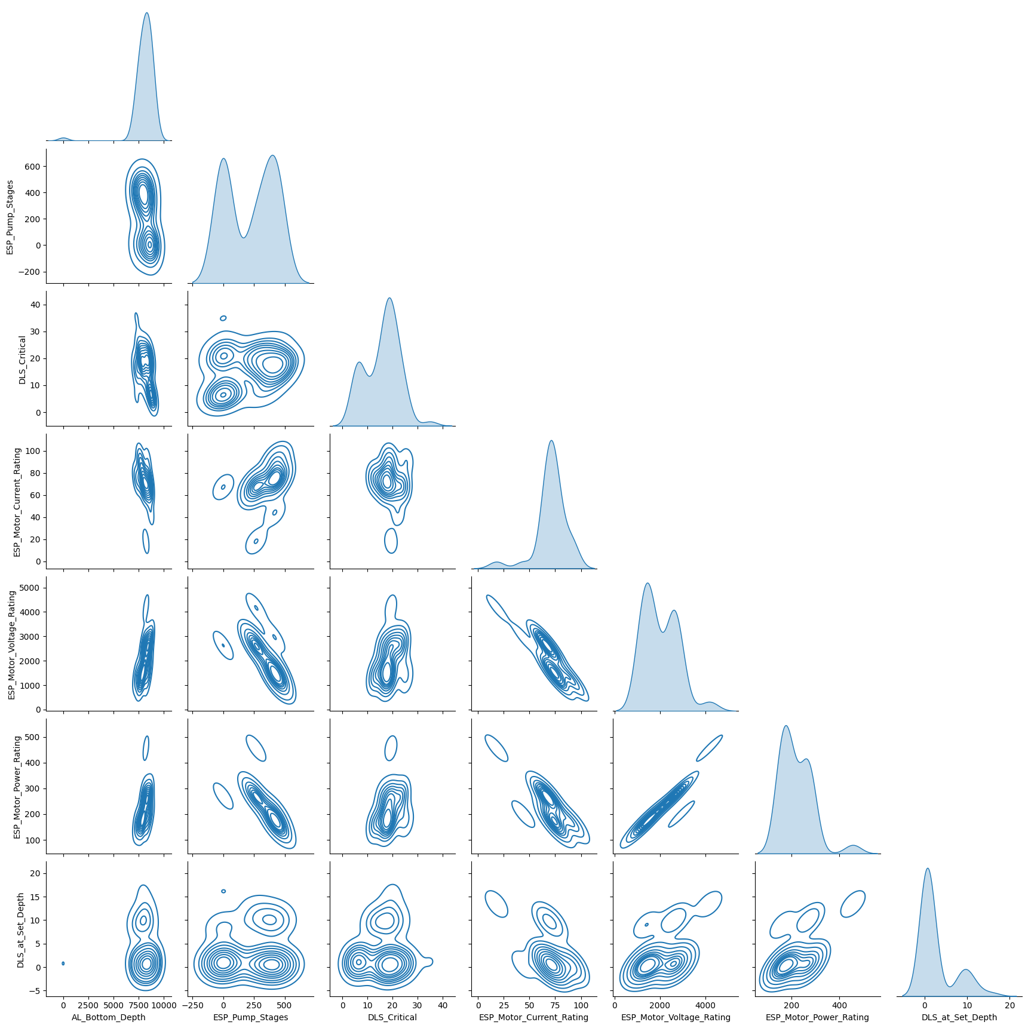
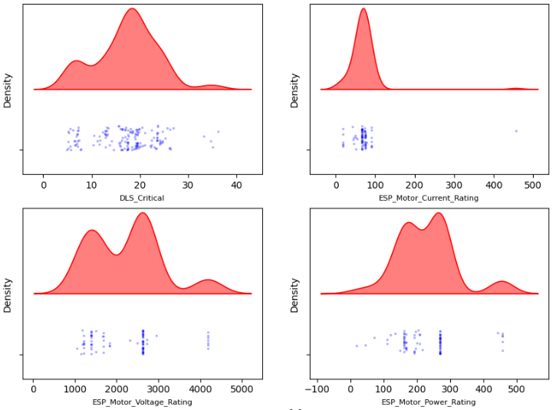
Data is gold, right?

Slide 12
How we hacked it
Feature selection :
36 + 14 to 10 only
WOR
GOR
Frequency
ESP Current E
ESP Voltage
Gas intake
Gas through Annulus
Pump DP
Power difference
ESP Temp.
Filter Data/Feature Selection
Sliding Window/SVM
Iteration Updates/K-Folds

Slide 13
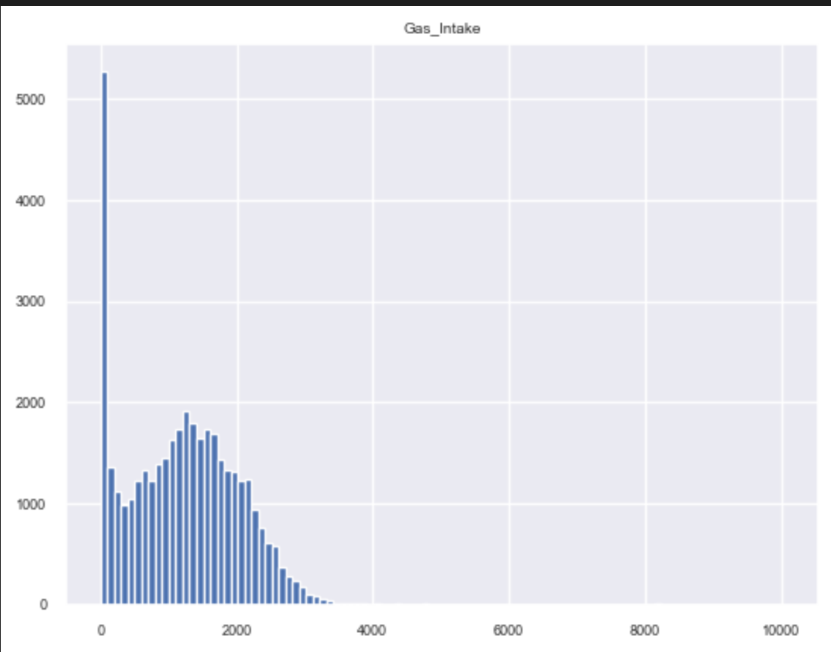
Some natural occurring zero-inflation that requires domain expertise
Filter Data/Feature Selection
Sliding Window/SVM
Iteration Updates/K-Folds
Gas Intake

Slide 14
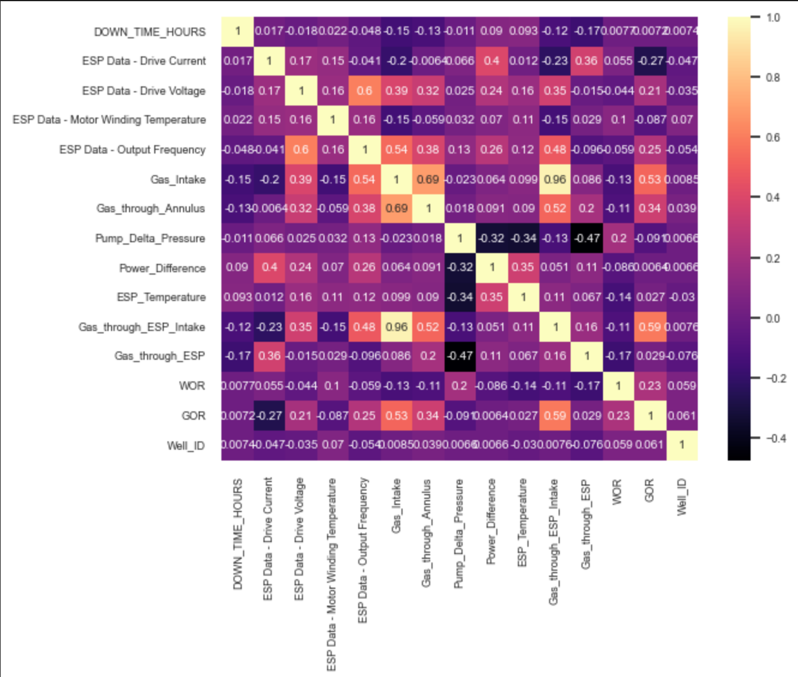
Domain expertise is not the only thing
Filter Data/Feature Selection
Sliding Window/SVM
Iteration Updates/K-Folds

Slide 15
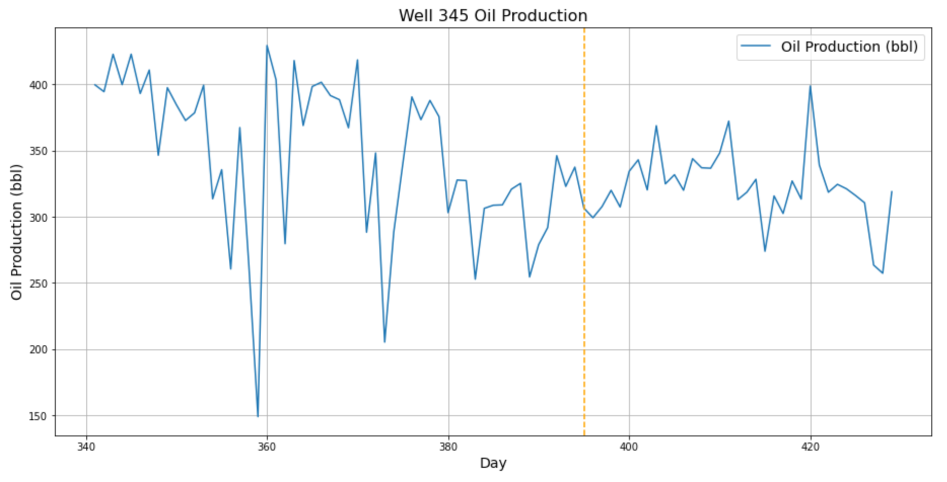
Feature engineering and
setting up a classification problem
Filter Data/Feature Selection
Sliding Window/SVM
Iteration Updates/K-Folds
30 Days
Mean, variance and kurtosis
There is a trade-off

Slide 16
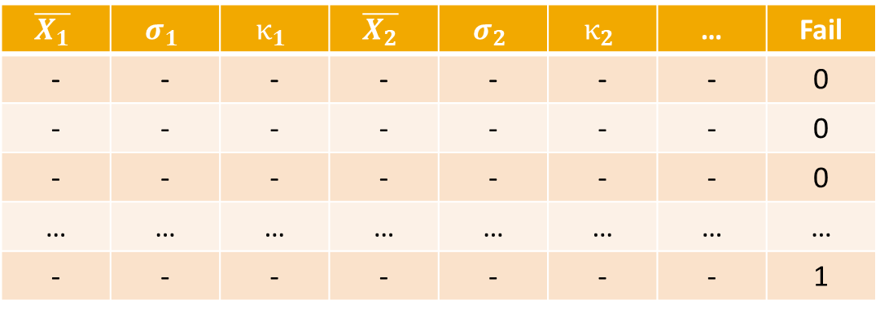
The imbalance problem
$$\overline{X_{1}}$$ | $$σ_{1}$$ | $$κ_{1}$$ | $$\overline{X_{2}}$$ | $$σ_{2}$$ | $$κ_{2}$$ | … | Fail
- | - | - | - | - | - | - | 0
- | - | - | - | - | - | - | 0
- | - | - | - | - | - | - | 0
… | … | … | … | … | … | … | …
- | - | - | - | - | - | - | 1

Slide 17
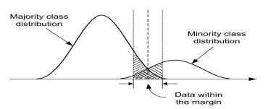
Dealing with imbalance
Undersampling the majority class
Random undersampling
Accuracy alone was not our guiding star
What about oversampling and other sophisticated methods?
[He & Garcia 2009]

Slide 18
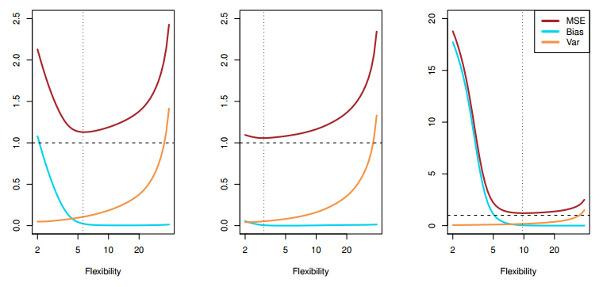
How we would hack it again
Increase the search space
$$E{\left[y_{0}−\hat{f}\left(x_{0}\right)\right]}^{2}=Var\left(\hat{f}\left(x_{0}\right)\right)+{\left[Bias\left(\hat{f}\left(x_{0}\right)\right)\right]}^{2}+Var\left(ε\right)$$
Model space: There is no free lunch.
Parameters and Hyperparameters: Informed search, instead of brute force.
Is the irreducible really irreducible?
The covariogram (what about the
window size?)
[James et al 2017]

Slide 19
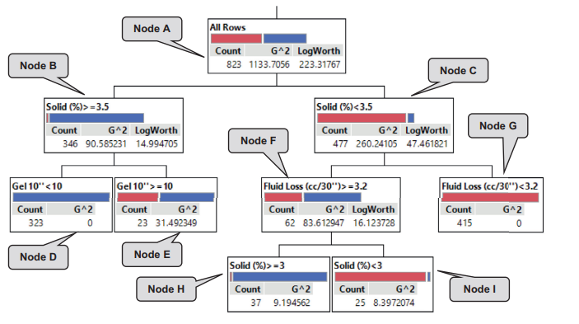
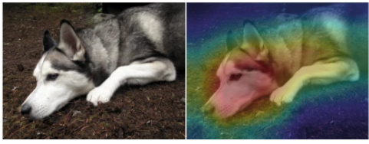
How we would hack it again
High-stakes decisions require interpretability
Explainable ML
Inherently Interpretable ML
[Rudin, et al 2019]
[Al Dushaishi, et al 2019]

Slide 20
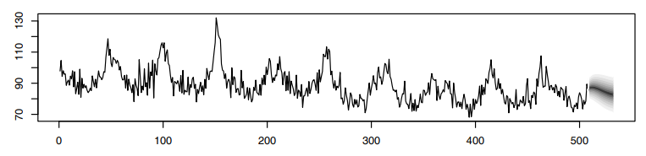

How we would hack it again
High-stakes decisions require to go beyond binary response
$$z_{t}\sim N\left(α z_{t−1}, σ^{2}\right)$$
$$α\sim N\left(μ_{α},σ_{α}^{2}\right)$$
$$σ^{2}\sim IG\left(μ_{α},σ_{α}^{2}\right)$$
[Shumway & Stoffer 2011]

Slide 21
Wrap up
Why the problem matters: Cost reduction
Work breakdown: Divide and succeed.
Data pre-processing tortuosity: Engineering the dataset.
Data imbalance: Undersampling approach.
Drillpy 2.0:
Widening the search space (e.g., model, window size).
Improved optimization of complexity and parameters.
Exploring distinct feature spaces.
Interpretability and uncertainty.

Slide 22
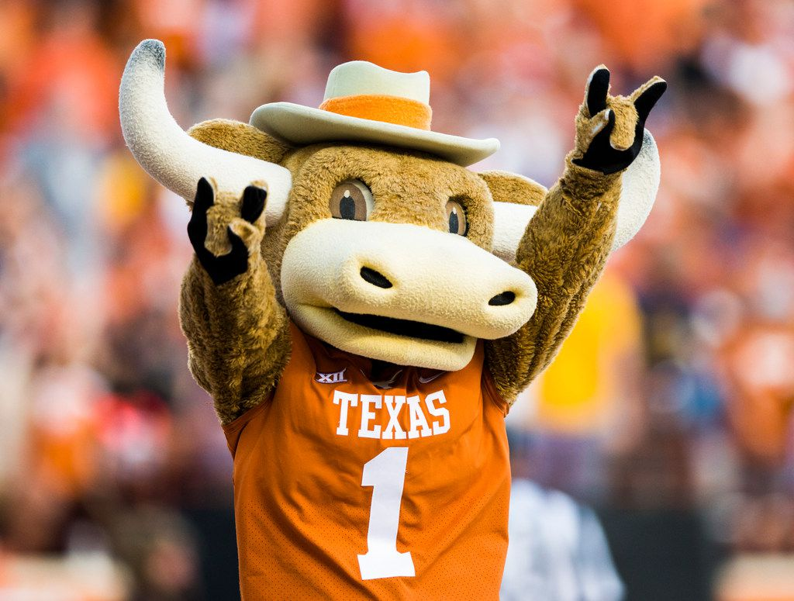
Thank you!!! Questions?

